Slide 1

Index
Bike Store
Database
Analysis

Slide 2





Introduction
Data Cleaning
Database Creation
Index
Importing Dataset
Business Questions
Result of analysis
Summary and recommendation

Slide 3
Introduction
Overview
The Bike Store Database Analysis project aims to analyze the sales data of a bike store to derive meaningful insights that can help in making informed business decisions. The project involves the extraction, transformation, and loading (ETL) of data into a structured database, followed by running SQL queries to answer specific business questions.
Tools and Technologies Used
Database Management System (DBMS): MySQL
Python
Jupyter Notebook
SQL Alchemy
PowerBi
Power Query Editor
Visualisation
Microsoft PowerPoint

Slide 4
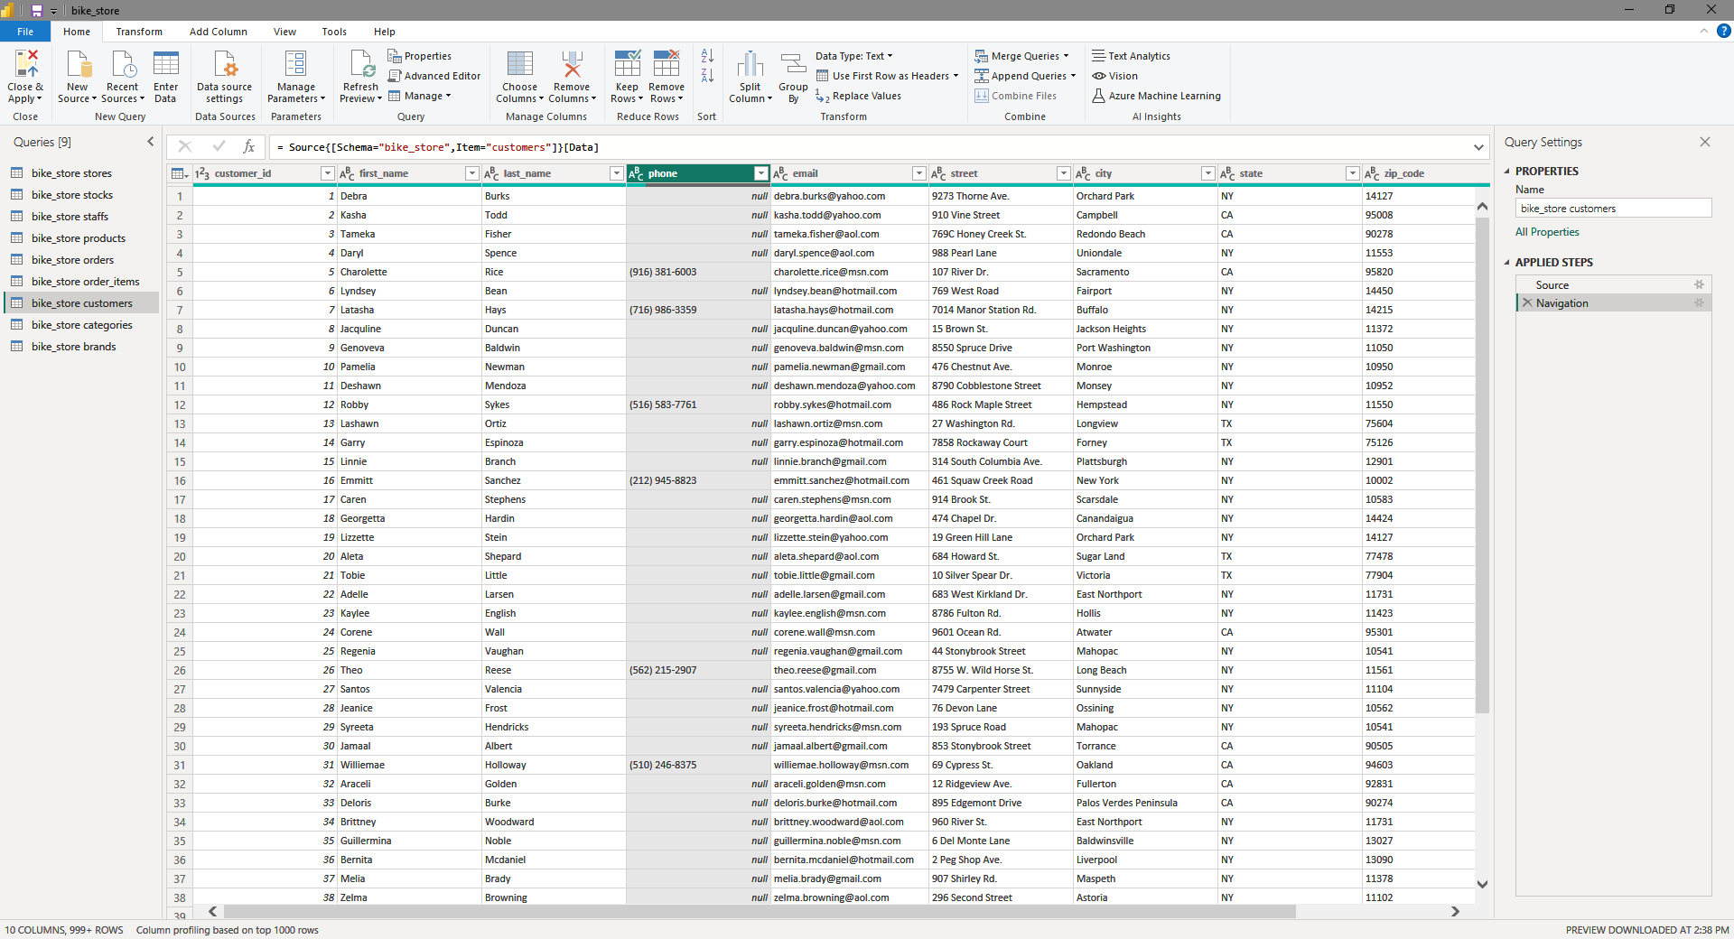
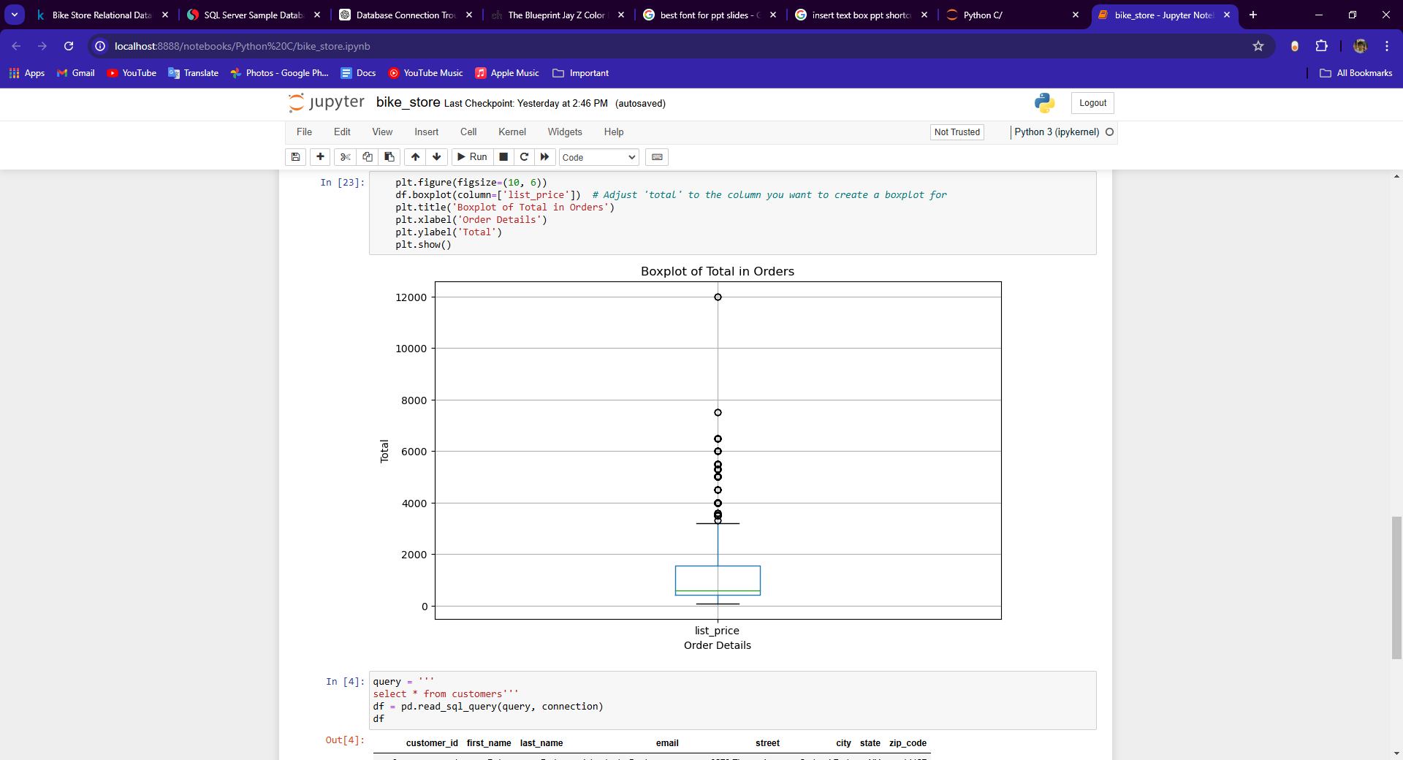
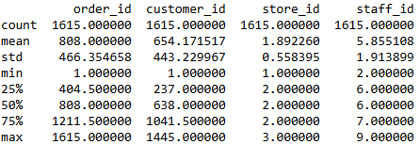
Introduction
Data Cleaning
Initial exploration | Handling missing Values | Transformation
Data cleaning is primarily done using the power query editor. missing values were identified and handled appropriately, either by filling them with suitable replacements or removing them altogether.
Additionally, box plots was made to detect and treat outliers.
Creating Box plot for treating outliers in the columns

Slide 5
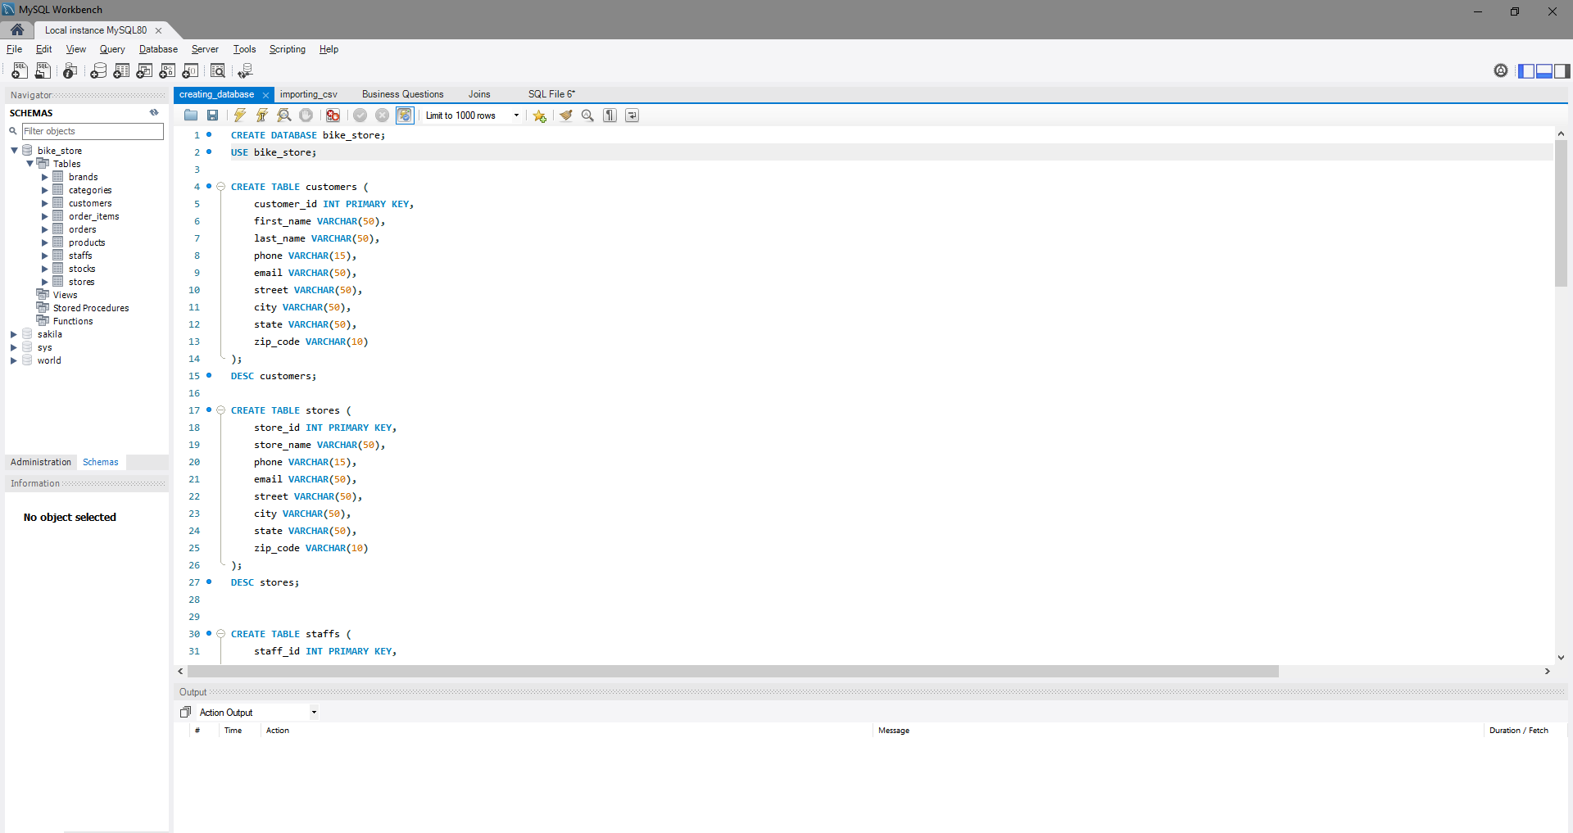
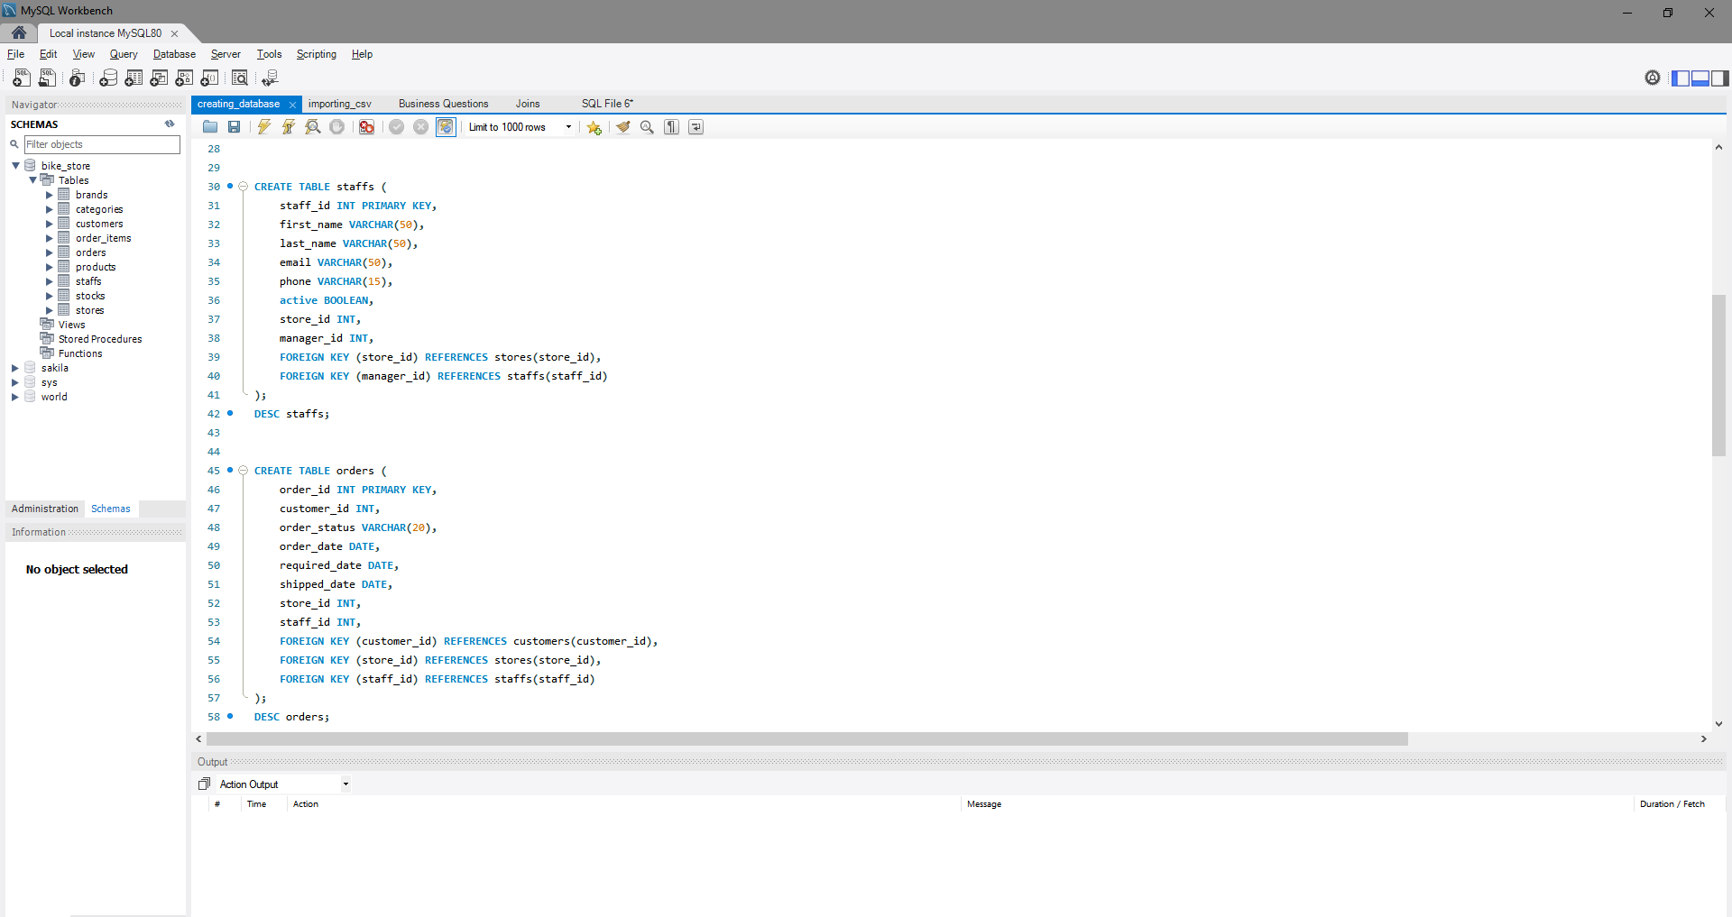
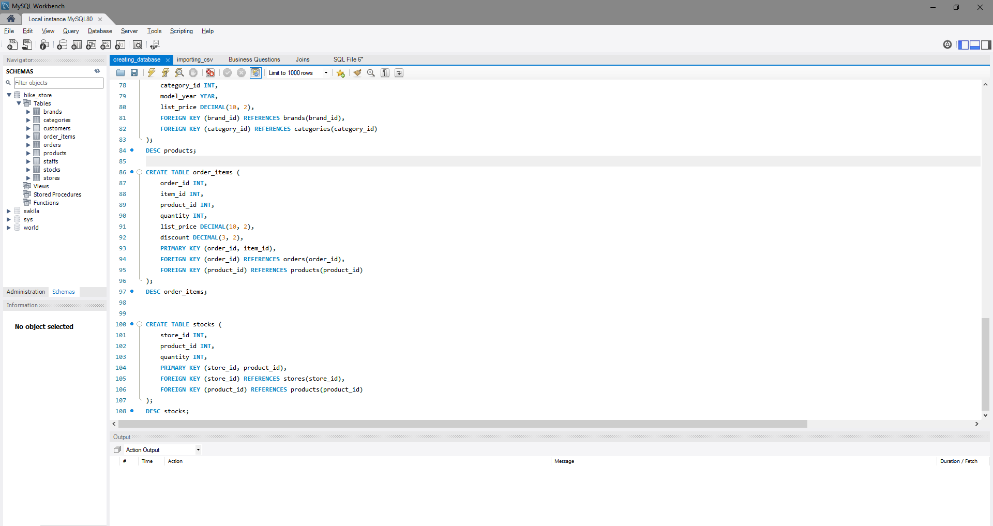
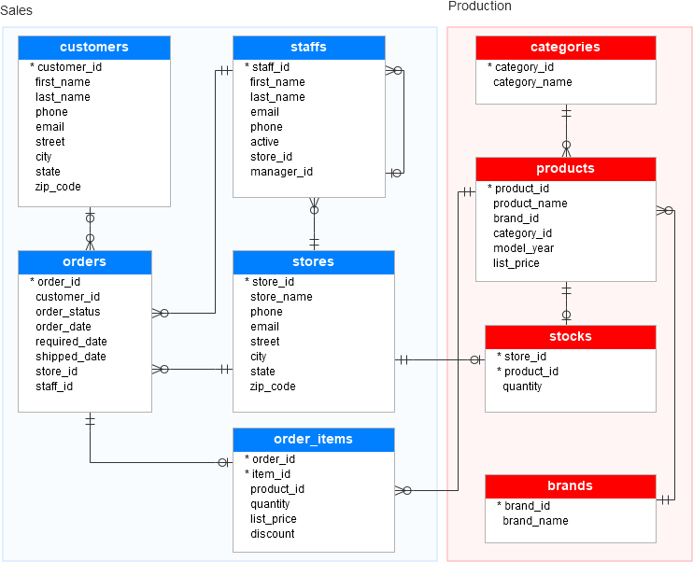
Introduction
Database Creation
A new database, "bike_store," was created using a well-defined database schema, incorporating suitable constraints for all columns to ensure data integrity and consistency. This involved setting primary and foreign keys, defining data types, and applying unique and not-null constraints, effectively organizing the bike store's data.
Data Model

Slide 6
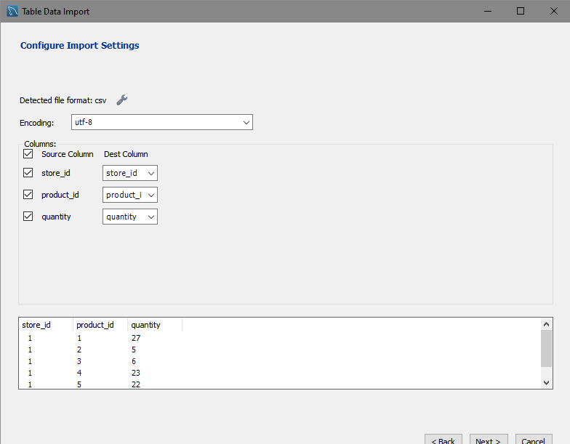
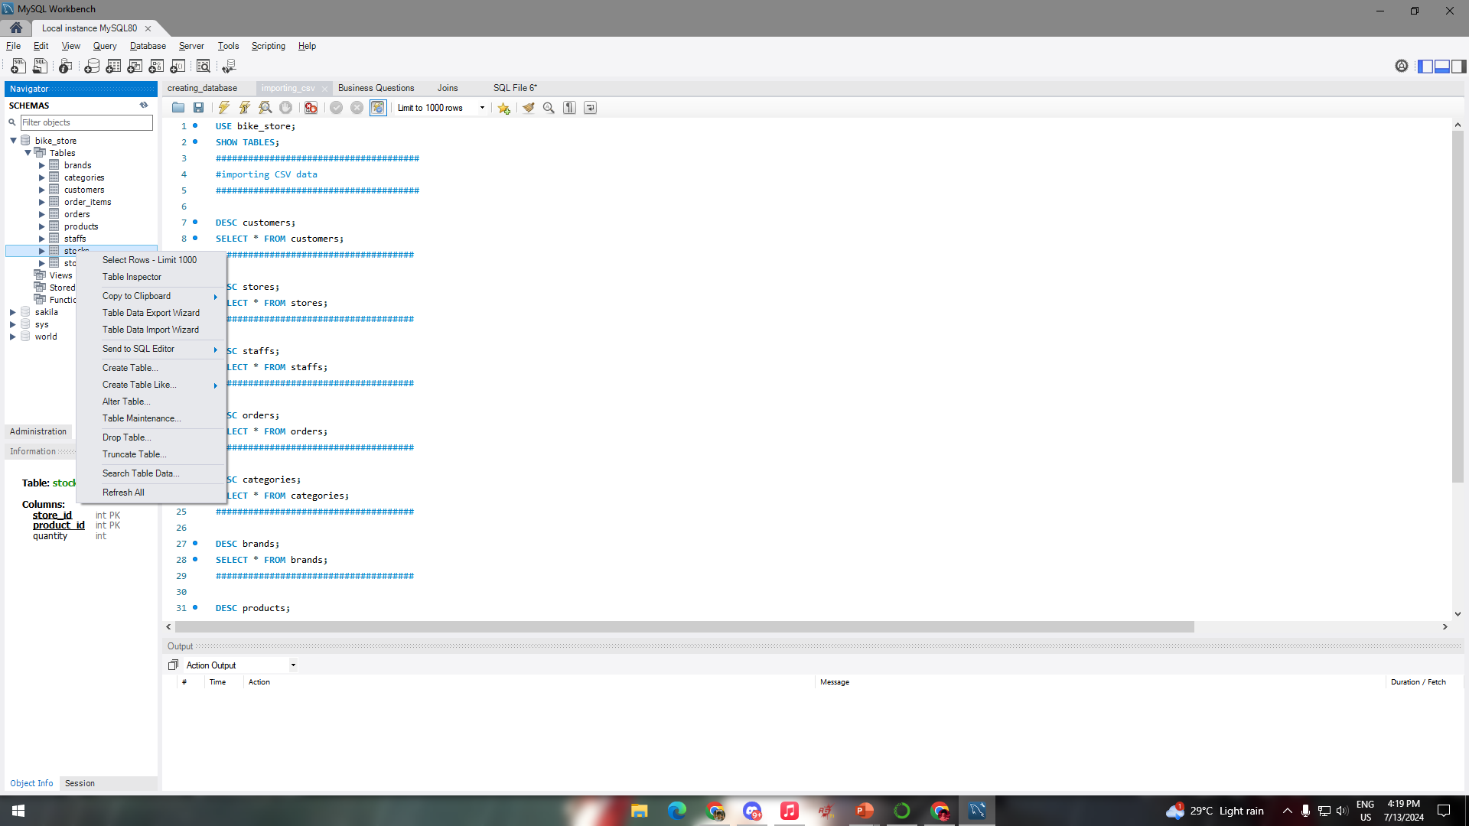
Introduction
Que.7
Que.7
Importing Dataset
Verifying Data Integrity
Que.6
Que.6
Loading Data into Tables using Table Data Import Wizard
Que.5
Que.5
Que.4
Que.4
Que.3
Que.3
Que.2
Que.2
Que.1
Que.1

Slide 7
Introduction
Que.7
Dashboard
Que.6
Que.6
Que.5
Que.5
Business
Questions
Que.4
Que.4
Que.3
Que.3
Que.2
Que.2
Que.1

Slide 8
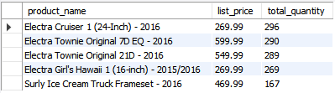
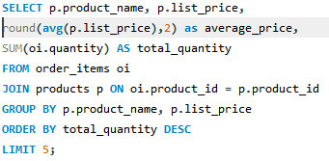
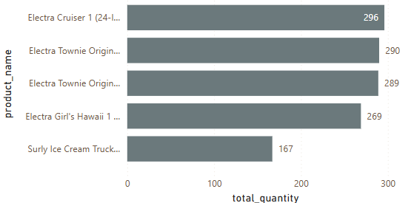
Introduction
Business Questions
Que.7
Dashboard
1. Which products are the top 5 bestsellers?
Que.6
Que.6
Que.5
Que.5
Business
Questions
Insight:-
The top 5 bestselling products have been identified based on the total quantity sold. Analysis reveals that all these highly sold products are priced well below the overall average list price of 1525.42. This indicates that lower-priced products are more popular among customers, suggesting a preference for affordability in their purchasing decisions.
Que.4
Que.4
Que.3
Que.3
Que.2
Que.1

Slide 9
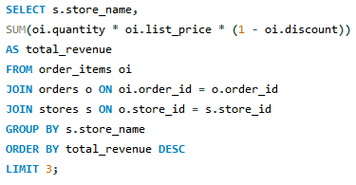
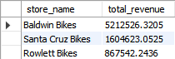
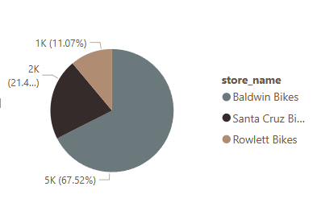
Introduction
Business Questions
Que.7
Dashboard
2. What are the top 5 stores in terms of sales revenue?
Que.6
Que.6
Que.5
Que.5
Insight:
Baldwin Bikes emerged as the top-selling brand with a total quantity sold of 4,774 units, significantly outperforming its competitors. Santa Cruz Bikes followed with 1,514 units sold, and Rowlett Bikes came in third with 783 units sold. Baldwin Bikes alone accounted for a substantial 67.52% of the total quantity sold, indicating its dominant market position.
Que.4
Que.4
Que.3
Que.3
Que.2
Que.1

Slide 10
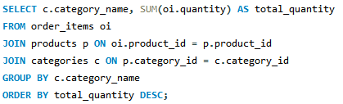
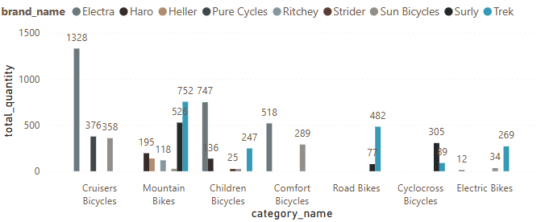
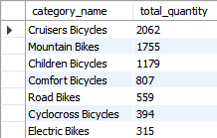
Introduction
Business Questions
Que.7
Dashboard
3. Which categories of products are the most popular?
Que.6
Que.6
Que.5
Que.5
Que.4
Que.4
Insight:-
Among all the categories, Cruiser Bicycles stand out as the most popular, capturing 29% of the market with over 2,000 sales. Within this category, the Electra brand leads significantly, selling 1,328 bicycles. This dominance highlights the strong consumer preference for Cruiser Bicycles, particularly those from the Electra brand.
Que.3
Que.3
Que.2
Que.1

Slide 11
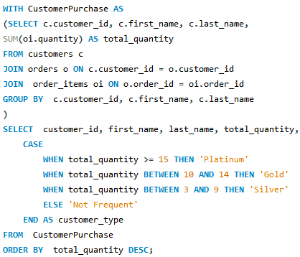
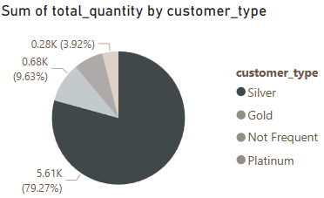
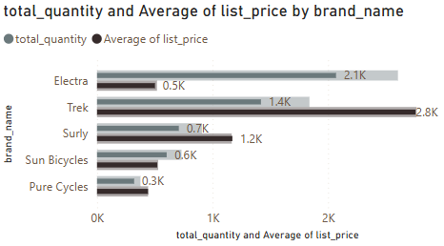
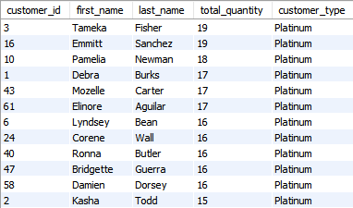
Introduction
Business Questions
Que.7
Dashboard
4. Dividing customers into types according to their purchase quantity.
Que.6
Que.6
Que.5
Que.5
Que.4
Insight:-
Customer type segmentation reveals that Silver customers, those who have purchased between 3 to 9 products, constitute the largest customer group. Within this segment, the Electra brand is the most popular, achieving over 2,000 sales at an average price of $500. Following Electra, the Trek brand has over 1,400 sales with a significantly higher average list price of $2,800. This indicates a strong preference among Silver customers for the Electra brand, likely due to its affordability and appealing features.
Que.4
Que.3
Que.3
Que.2
Que.1

Slide 12
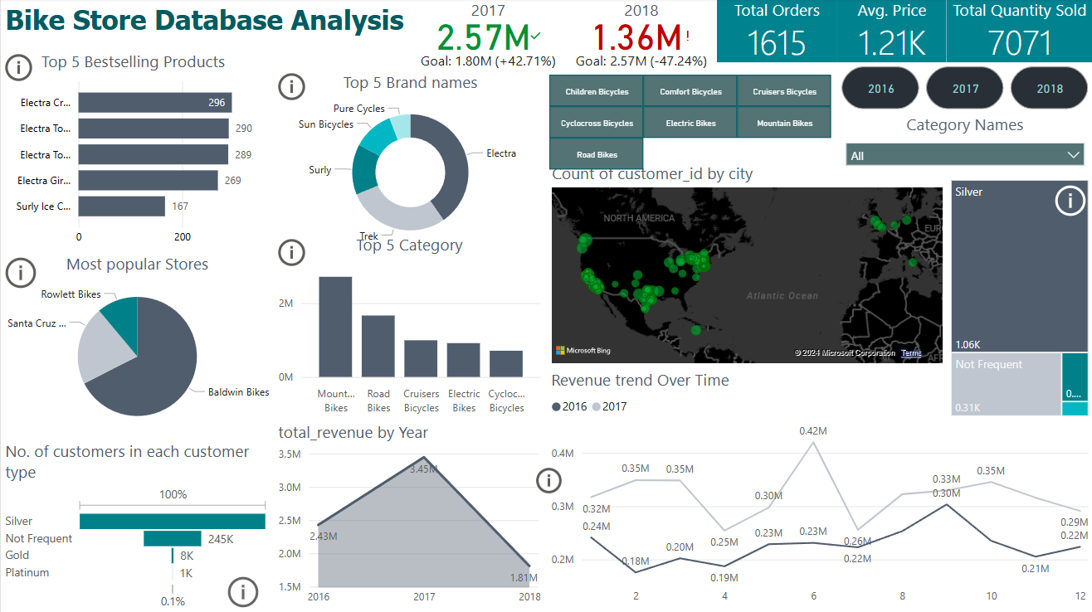
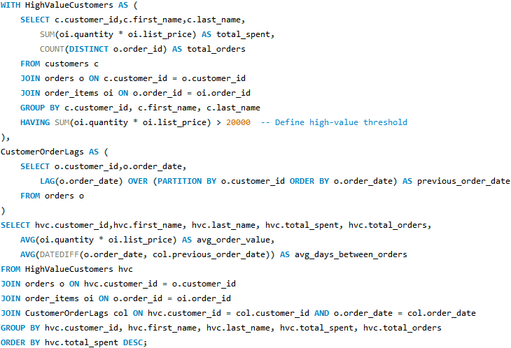
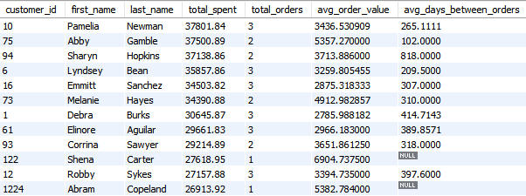
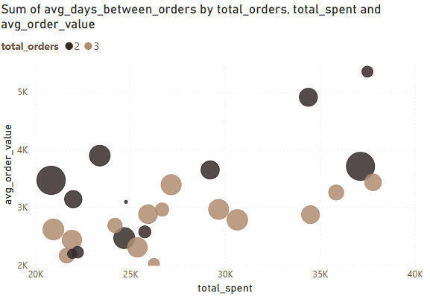
Introduction
Business Questions
Que.7
Dashboard
5. What are the purchasing patterns of high-value customers and how can they be incentivized to increase their purchase frequency?
Que.6
Que.6
Que.5
Que.5
Que.4
Que.4
Que.3
Insight:-
The analysis reveals significant customer behavior patterns. Customers with the highest total spending typically place 2-3 orders within a specific period. These high-value customers have an average order value of $3,860 and an average interval of 306 days between their orders. This pattern indicates a trend where high spenders make fewer, but larger, purchases over a relatively longer timeframe.
Que.3
Que.2
Que.1

Slide 13
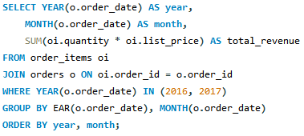
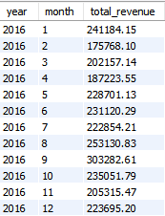
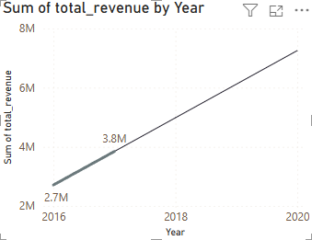
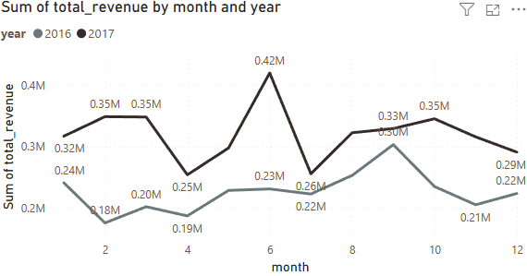
Introduction
Business Questions
Que.7
Dashboard
6.How did monthly sales revenue trend in 2016 and 2017, and what strategies can be implemented to capitalize on periods of high revenue?
Que.6
Que.6
Que.5
Que.5
Que.4
Que.4
Que.3
Insight:-
2016: Average Monthly Revenue: $225k
Total Annual Revenue: $2.7M
2017: Average Monthly Revenue: $320k
Total Annual Revenue: $3.8M
There is a notable increase in average monthly revenue from $225k in 2016 to $320k in 2017, representing a 42.2% increase.
Total annual revenue grew from $2.7 million in 2016 to $3.8 million in 2017, a 40.7% increase
Que.3
Que.2
Que.1

Slide 14
Introduction
Result of analysis
Que.7
Dashboard
Bestselling Products:
The top 5 bestselling products are priced below the average list price of $1525.42.
Lower-priced products are more popular among customers, indicating a preference for affordability.
Que.6
Que.6
Top-Selling Brands:
Baldwin Bikes: 4,774 units sold (67.52% market share).
Santa Cruz Bikes: 1,514 units sold.
Rowlett Bikes: 783 units sold.
Que.5
Que.5
Que.4
Que.4
Popular Product Categories:
Cruiser Bicycles: Most popular category with 29% market share.
Electra Brand: Leading within Cruiser Bicycles, with 1,328 bikes sold.
Que.3
Que.3
Revenue Trends:
2016: Average Monthly Revenue: $225k, Total Annual Revenue: $2.7M.
2017: Average Monthly Revenue: $320k, Total Annual Revenue: $3.8M.
Notable 42.2% increase in average monthly revenue and 40.7% increase in total annual revenue from 2016 to 2017.
Que.2
Que.1

Slide 15
Summary and Recommendations
Result of analysis
Result
Summary:-
The analysis of the bike store data reveals several critical insights into customer purchasing behavior, product popularity, and revenue trends over 2016 and 2017. Key findings indicate a preference for lower-priced products, a dominant market position for Baldwin Bikes, and significant popularity for Cruiser Bicycles, especially those from the Electra brand. Furthermore, Silver customers form the largest customer segment, showing a strong inclination towards the affordability of Electra bikes. The revenue analysis highlights a substantial increase in both average monthly and total annual revenue from 2016 to 2017, underscoring successful business strategies and growth.
Bestselling Products:
The top 5 bestselling products are priced below the average list price of $1525.42.
Lower-priced products are more popular among customers, indicating a preference for affordability.
Que.6
Summary and Recomendation
Top-Selling Brands:
Baldwin Bikes: 4,774 units sold (67.52% market share).
Santa Cruz Bikes: 1,514 units sold.
Rowlett Bikes: 783 units sold.
Que.5
Que.4
Popular Product Categories:
Cruiser Bicycles: Most popular category with 29% market share.
Electra Brand: Leading within Cruiser Bicycles, with 1,328 bikes sold.
Enhance Marketing for Lower-Priced Products
Leverage Baldwin Bikes' Dominance
Focus on Cruiser Bicycles and Electra Brand
Target Silver Customers
Optimize Revenue During High-Demand Periods
Que.3
Que.3
Revenue Trends:
2016: Average Monthly Revenue: $225k, Total Annual Revenue: $2.7M.
2017: Average Monthly Revenue: $320k, Total Annual Revenue: $3.8M.
Notable 42.2% increase in average monthly revenue and 40.7% increase in total annual revenue from 2016 to 2017.
Que.2
Que.1

Slide 16
Summary and Recommendations
Result of analysis
Result
Summary:-
The analysis of the bike store data reveals several critical insights into customer purchasing behavior, product popularity, and revenue trends over 2016 and 2017. Key findings indicate a preference for lower-priced products, a dominant market position for Baldwin Bikes, and significant popularity for Cruiser Bicycles, especially those from the Electra brand. Furthermore, Silver customers form the largest customer segment, showing a strong inclination towards the affordability of Electra bikes. The revenue analysis highlights a substantial increase in both average monthly and total annual revenue from 2016 to 2017, underscoring successful business strategies and growth.
Bestselling Products:
The top 5 bestselling products are priced below the average list price of $1525.42.
Lower-priced products are more popular among customers, indicating a preference for affordability.
Que.6
Summary and Recomendation
Thank
Que.5
Top-Selling Brands:
Baldwin Bikes: 4,774 units sold (67.52% market share).
Santa Cruz Bikes: 1,514 units sold.
Rowlett Bikes: 783 units sold.
You
Que.4
Popular Product Categories:
Cruiser Bicycles: Most popular category with 29% market share.
Electra Brand: Leading within Cruiser Bicycles, with 1,328 bikes sold.
Enhance Marketing for Lower-Priced Products
Leverage Baldwin Bikes' Dominance
Focus on Cruiser Bicycles and Electra Brand
Target Silver Customers
Optimize Revenue During High-Demand Periods
Que.3
Que.3
Revenue Trends:
2016: Average Monthly Revenue: $225k, Total Annual Revenue: $2.7M.
2017: Average Monthly Revenue: $320k, Total Annual Revenue: $3.8M.
Notable 42.2% increase in average monthly revenue and 40.7% increase in total annual revenue from 2016 to 2017.
Que.2
Que.1

Slide 17
Summary and Recommendations
Result of analysis
Result
Bestselling Products:
The top 5 bestselling products are priced below the average list price of $1525.42.
Lower-priced products are more popular among customers, indicating a preference for affordability.
Summary:-
The analysis of the bike store data reveals several critical insights into customer purchasing behavior, product popularity, and revenue trends over 2016 and 2017. Key findings indicate a preference for lower-priced products, a dominant market position for Baldwin Bikes, and significant popularity for Cruiser Bicycles, especially those from the Electra brand. Furthermore, Silver customers form the largest customer segment, showing a strong inclination towards the affordability of Electra bikes. The revenue analysis highlights a substantial increase in both average monthly and total annual revenue from 2016 to 2017, underscoring successful business strategies and growth.
Que.6
Summary and Recomendation
Thank
Que.5
Top-Selling Brands:
Baldwin Bikes: 4,774 units sold (67.52% market share).
Santa Cruz Bikes: 1,514 units sold.
Rowlett Bikes: 783 units sold.
You
Que.4
Popular Product Categories:
Cruiser Bicycles: Most popular category with 29% market share.
Electra Brand: Leading within Cruiser Bicycles, with 1,328 bikes sold.
Enhance Marketing for Lower-Priced Products
Leverage Baldwin Bikes' Dominance
Focus on Cruiser Bicycles and Electra Brand
Target Silver Customers
Optimize Revenue During High-Demand Periods
Que.3
Que.3
Revenue Trends:
2016: Average Monthly Revenue: $225k, Total Annual Revenue: $2.7M.
2017: Average Monthly Revenue: $320k, Total Annual Revenue: $3.8M.
Notable 42.2% increase in average monthly revenue and 40.7% increase in total annual revenue from 2016 to 2017.
Que.2
Que.1

